Slide 1
Copyright Notice
These slides are distributed under the Creative Commons License.
DeepLearning.AI makes these slides available for educational purposes. You may not use or distribute these slides for commercial purposes. You may make copies of these slides and use or distribute them for educational purposes as long as you cite DeepLearning.AI as the source of the slides.
For the rest of the details of the license, see https://creativecommons.org/licenses/by-sa/2.0/legalcode

Slide 2


Math for Machine Learning
Linear algebra - Week 1
Systems of linear equations Singular and non-singular matrices Determinants
Rank of a matrix Row reduction Null space

Slide 3
System of Linear Equations
Machine learning motivation

Slide 4

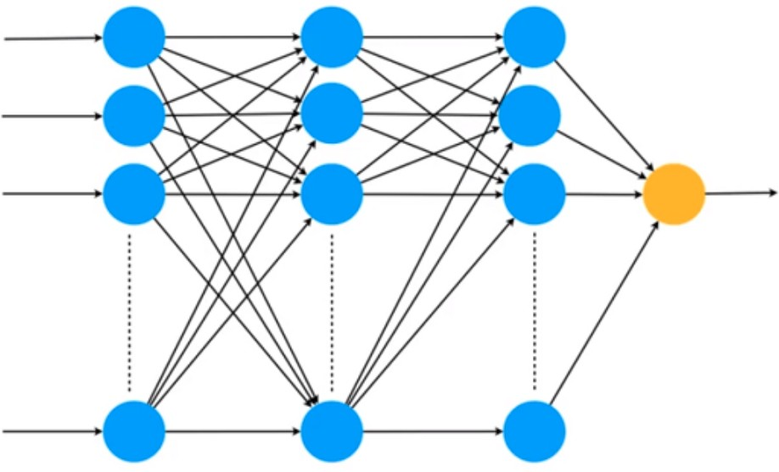









Neural networks - Matrix operations
Yes, it’s a face
Matrix
Matrix
Matrix
Matrix

Slide 5

Neural networks - image recognition
Image recognition in a busy street in New York.
Image recognition: Getting the computer to see images and recognize what is on them.

Slide 6
System of Linear Equations
System of sentences

Slide 7





Systems of sentences
System 1
System 2
System 3
The dog is black
The cat is orange
The dog is black
The dog is black
The dog is black
The dog is white
Complete
Redundant
Contradictory
Non-singular
Singular
Singular

Slide 8



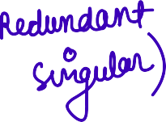
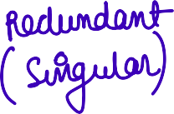



Systems of sentences
System 1
System 2
System 3
System 4
The dog is black The cat is orange The bird is red
The dog is black The dog is black The bird is red
The dog is black The dog is black The dog is black
The dog is black The dog is white The bird is red

Slide 9
Systems of sentences
System 1 | System 2 | System 3 | System 4
The dog is black | The dog is black | The dog is black | The dog is black
The cat is orange | The dog is black | The dog is black | The dog is white
The bird is red | The bird is red | The dog is black | The bird is red
Complete | Redundant | Redundant | Contradictory
Non-singular | Singular | Singular | Singular

Slide 10



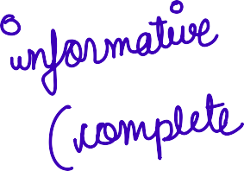

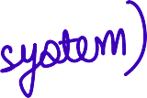


Quiz: Systems of sentences
Given this system:
Between the dog, the cat, and the bird, one is red.
Between the dog and the cat, one is orange.
The dog is black.
Problem 1:
What color is the bird?
Problem 2:
Is this system singular or non-singular?

Slide 11
System of Linear Equations
System of equations

Slide 12

Sentences → Equations
Sentences
Sentences with numbers
Equations
Between the dog and the cat, one is black.
The price of an apple and a banana is $10.
a + b = 10

Slide 13




Quiz: Systems of equations 1
You go two days in a row and collect this information:
Day 1: You bought an apple and a banana and they cost $10.
Day 2: You bought an apple and two bananas and they cost $12.
Question: How much does each fruit cost?

Slide 14
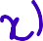



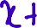

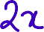
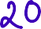
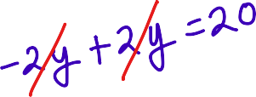
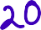

Quiz: Systems of equations 2
You go two days in a row and collect this information:
Day 1: You bought an apple and a banana and they cost $10.
Day 2: You bought two apples and two bananas and they cost $20.
Question: How much does each fruit cost?

Slide 15

Solution: Systems of equations 2
Day 1: You bought an apple and a banana and they cost $10.
+ = $10
Day 2: You bought two apples and two bananas and they cost $20.
+ = $20
Same thing!!!
8
5 5
8.3 1.7
0 10
2
Infinitely many solutions!

Slide 16







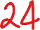



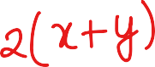
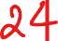

Quiz: Systems of equations 3
You go two days in a row and collect this information:
Day 1: You bought an apple and a banana and they cost $10.
Day 2: You bought two apples and two bananas and they cost $24.
Question: How much does each fruit cost?

Slide 17



Solution: Systems of equations 3
Day 1: You bought an apple and a banana and they cost $10.
+ = $10 +
= $20
Day 2: You bought two apples and two bananas and they cost $24.
+ = $24
Contradiction!
No solutions!

Slide 18
Systems of equations
System 1 | System 2 | System 3
a + b = 10 | a + b = 10 | a + b = 10
a + 2b = 12 | 2a + 2b = 20 | 2a + 2b = 24
Unique solution: | Infinite solutions | No solution
a = 8
b = 2
a = 8 , 7 , 6
b = 2 3 4
…
Complete | Redundant | Contradictory
Non-singular | Singular | Singular

Slide 19
What is a linear equation?
Linear
Non-linear

Slide 20
System of Linear Equations
System of equations as lines

Slide 21
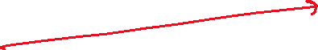
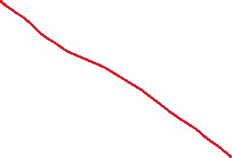
Linear equation → line

Slide 22






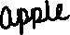
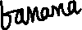
Linear equation → line
b
b
(-4,14)
(0,10)
(-4,8)
(4,6)
(0,6)
a + b = 10
a + 2b = 12
(8,2)
(8,2)
(10,0)
(12,0)
a
a
(12,-2)

Slide 23

Linear equation → line
b
b
(-4,14)
slope = -1
(0,10)
y-intercept = 10
(-4,8)
slope = -0.5
(4,6)
(0,6)
a + b = 10
a + 2b = 12
(8,2)
(8,2)
y-intercept = 6
(10,0)
(12,0)
a
a
(12,-2)

Slide 24





Linear equation → line
b
Unique solution!
a + b = 10 a + 2b = 12
(8,2)
a

Slide 25
Linear equation → line
b
b
(0,10)
(0,10)
a + b = 10
2a + 2b = 20
(10,0)
a
(10,0)
a

Slide 26
Linear equation → line
b
a + b = 10 2a + 2b = 20
a

Slide 27


Linear equation → line
b
Every point in the line Is a solution!
a + b = 10 2a + 2b = 20
a

Slide 28
Linear equation → line
b
b
(0,12)
(0,10)
a + b = 10
2a + 2b = 24
(10,0)
a
a
(12,0)

Slide 29

Linear equation → line
b
No solutions
a + b = 10 2a + 2b = 24
a

Slide 30
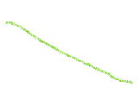
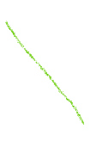
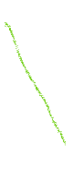
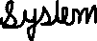
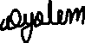
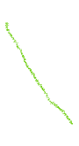
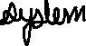
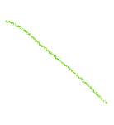
Systems of equations as lines

Slide 31


Systems of equations as lines
System 1 System 2
• a + b = 10 • a + b = 10
• a + 2b = 12 • 2a + 2b = 20
System 3
a + b = 10
2a + 2b = 24
b Unique solution
b
b
No
solutions
Infinite solutions
(8,2)
a
a
a
Complete Non-singular
Redundant Singular
Contradictory Singular

Slide 32







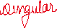
Quiz
Problem 1
Which of the following plots corresponds to the system of equations:
3a + 2b = 8
2a - b = 3
a) b) c)
d)
Problem 2
Is this system singular or non-singular?

Slide 33



Solution
Problem 1
b
Problem 2
Since the lines cross at a unique point, the system is non-singular.
a)
(0,4)
2a - b = 3
(2,1)
a
(3/2,0)
(8/3,0)
(0,-3)
3a + 2b = 8

Slide 34
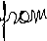

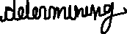
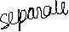
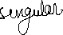
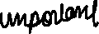
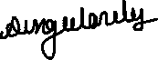
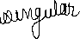
System of Linear Equations
A geometric notion of singularity

Slide 35




Systems of equations as lines
System 1 System 2
• a + b = 10 • a + b = 10
• a + 2b = 12 • 2a + 2b = 20
System 3
a + b = 10
2a + 2b = 24
0
0
0
0
0
0
b b
b
Unique solution
Infinite solutions
No solutions
(8,2)
a
a
a
Complete Non-singular
Redundant Singular
Contradictory Singular

Slide 36




Systems of equations as lines
System 1 System 2
• a + b = 0 • a + b = 0
• a + 2b = 0 • 2a + 2b = 0
b b
System 3
a + b = 0
2a + 2b = 0
b
Infinite solutions
Infinite solutions
Unique solution
a
a
a
Complete Non-singular
Redundant Singular
Redundant Singular

Slide 37
System of Linear Equations
Singular vs nonsingular
matrices

Slide 38
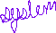

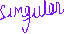
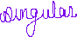

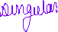


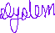

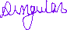
Systems of equations as matrices
System 1 System 2
• a + b = 0 • a + b = 0
• a + 2b = 0 • 2a + 2b = 0
10
12
10
20

Slide 39
System of Linear Equations
Linear dependence and independence

Slide 40









Linear dependence between rows
Non-singular Singular system
• a + b = 0 • a + b = 0
• a + 2b = 0 • 2a + 2b = 0
10
12
1 | 1
1 | 2
10
20
1 | 1
2 | 2

Slide 41
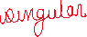
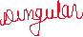

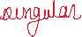

System of Linear Equations
The determinant

Slide 42

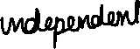
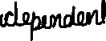
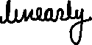

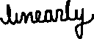
Linear dependence between rows
Non-singular matrix
Singular matrix
1 | 1
1 | 2
1 | 1
2 | 2

Slide 43




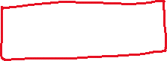

Determinant
a | b
c | d
Matrix is singular if
a
b
* k =
c
d

Slide 44






Determinant
ak c
k d
a | b
c | d
Determinant
ad bc
c d
a b
a
 | d
-
 | b
c
= = k
Matrix is singular if
ad bc
a
b
* k =
c
d
Determinant
ad bc

Slide 45








Determinant
Non-singular matrix
Singular matrix
1 | 1
1 | 2
1 | 1
2 | 2

Slide 46
Determinant and singularity
a | b
c | d
ad bc
Determinant is zero
Matrix is singular

Slide 47


Quiz: Determinant
Problem 1: Find the determinant of the following matrices
Matrix 1
5 | 1
-1 | 3
Matrix 2
2 | -1
-6 | 3
Problem 2: Are these matrices singular or non-singular?

Slide 48
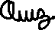
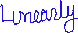

Slide 49
System of Linear Equations
System of equations (3x3)

Slide 50
Quiz: Systems of equations
Problem 1: You’re trying to figure out the price of apples, bananas, and cherries at the store. You go three days in a row, and bring this information.
Day 1: You bought an apple, a banana, and a cherry, and paid $10.
Day 2: You bought an apple, two bananas, and a cherry, and paid $15.
Day 3: You bought an apple, a banana, and two cherries, and paid $12. How much does each fruit cost?

Slide 51








Solution: Systems of equations

Slide 52




Solution: Systems of equations
System of equations 1
$5 $2
$10
$3
a + b + c = 10 a + 2b + c = 15 a + b + 2c = 12
$15
$5
Solution
a = 3
b = 5
c = 2
$12
$2

Slide 53











Quiz: More systems of equations
System 2 | System 3 | System 4
a + b + c = 10 | a + b + c = 10 | a + b + c = 10
a + b + 2c = 15 | a + b + 2c = 15 | 2a + 2b + 2c = 20
a + b + 3c = 20 | a + b + 3c = 18 | 3a + 3b + 3c = 30

Slide 54
Solutions: More systems of equations
System 2 System 3 System 4
a + b + c = 10 a + b + 2c = 15 a + b + 3c = 20
a + b + c = 10 a + b + 2c = 15 a + b + 3c = 18
a + b + c = 10
2a + 2b + 2c = 20
3a + 3b + 3c = 30
Infinitely many sols.
c = 5
a + b = 5
(0,5,5), (1,4,5), (2,3,5), …
No solutions
From 1st and 2nd: c = 5
From 2nd and 3rd: c = 3
Infinitely many solutions
Any 3 numbers that add to 10 work.
(0,0,10), (2,7,1), …

Slide 55
System of Linear Equations
Singular vs non-singular
matrices

Slide 56










Constants don’t matter for singularity
System 1 | System 2 | System 3 | System 4
a + b + c = 10 | a + b + c = 10 | a + b + c = 10 | a + b + c = 10
a + 2b + c = 15 | a + b + 2c = 15 | a + b + 2c = 15 | 2a + 2b + 2c = 15
a + b + 2c = 12 | a + b + 3c = 20 | a + b + 3c = 18 | 3a + 3b + 3c = 20

Slide 57

Constants don’t matter for singularity
System 1 | System 2 | System 3 | System 4
a + b + c = 10 | a + b + c = 10 | a + b + c = 10 | a + b + c = 10
a + 2b + c = 15 | a + b + 2c = 15 | a + b + 2c = 15 | 2a + 2b + 2c = 20
a + b + 2c = 12 | a + b + 3c = 20 | a + b + 3c = 18 | 3a + 3b + 3c = 30
a + b + c = 0 a + 2b + c = 0 a + b + 2c = 0
a + b + c = 0 a + b + 2c = 0 a + b + 3c = 0
a + b + c = 0 a + b + 2c = 0 a + b + 3c = 0
a + b + c = 0
2a + 2b + 2c = 0
3a + 3b + 3c = 0

Slide 58
Constants don’t matter for singularity
System 1 | System 2 | System 3 | System 4
a + b + c = 0 | a + b + c = 0 | a + b + c = 0 | a + b + c = 0
a + 2b + c = 0 | a + b + 2c = 0 | a + b + 2c = 0 | 2a + 2b + 2c = 0
a + b + 2c = 0 | a + b + 3c = 0 | a + b + 3c = 0 | 3a + 3b + 3c = 0

Slide 59













Constants don’t matter for singularity
System 1 | System 2 | System 3 | System 4
a + b + c = 0 | a + b + c = 0 | a + b + c = 0 | a + b + c = 0
a + 2b + c = 0 | a + b + 2c = 0 | a + b + 2c = 0 | 2a + 2b + 2c = 0
a + b + 2c = 0 | a + b + 3c = 0 | a + b + 3c = 0 | 3a + 3b + 3c = 0
Unique solution:
a = 0
b = 0
c = 0
Infinite solutions:
c = 0
a + b = 0 (i.e., a = -b)
Infinite solutions:
a + b +c = 0 (i.e., c = - a - b)
Complete Non-singular
Redundant Singular
Redundant Singular

Slide 60
Constants don’t matter for singularity
System 1 | System 2 | System 3 | System 4
a + b + c = 0 | a + b + c = 0 | a + b + c = 0 | a + b + c = 0
a + 2b + c = 0 | a + b + 2c = 0 | a + b + 2c = 0 | 2a + 2b + 2c = 0
a + b + 2c = 0 | a + b + 3c = 0 | a + b + 3c = 0 | 3a + 3b + 3c = 0
1 | 1 | 1
1 | 2 | 1
1 | 1 | 2
1 | 1 | 1
1 | 1 | 2
1 | 1 | 3
1 | 1 | 1
2 | 2 | 2
3 | 3 | 3
Non-singular
Singular
Singular

Slide 61
System of Linear Equations
System of equations as planes (3x3)

Slide 62



Linear equation in 3 variables -> Plane
b
a + b + c = 1
c
1 + 0 + 0 = 1
(0,1,0)
0 + 1 + 0 = 1
(1,0,0)
a
0 + 0 + 1 = 1
(0,0,1)

Slide 63

Linear equation in 3 variables -> Plane
b
3a - 5b + 2c = 0
c
3(0) + 5(0) + 2(0) = 0
(0,0,0)
a

Slide 64

System 1
b
System 1
a + b + c = 0
c
a + 2b + c = 0
a + b + 2c = 0
(0,0,0)
a

Slide 65


System 1
b
System 1
a + b + c = 0
c
a + 2b + c = 0
a + b + 2c = 0
(0,0,0)
a

Slide 66



System 1
b
System 1
a + b + c = 0
c
a + 2b + c = 0
a + b + 2c = 0
(0,0,0)
a

Slide 67
System 2
b
System 2
a + b + c = 0
c
a + b + 2c = 0
a + b + 3c = 0
a

Slide 68

System 2
b
System 2
a + b + c = 0
c
a + b + 2c = 0
a + b + 3c = 0
a

Slide 69


System 2
b
System 2
a + b + c = 0
c
a + b + 2c = 0
a + b + 3c = 0
a

Slide 70


System 2
b
System 2
a + b + c = 0
c
a + b + 2c = 0
a + b + 3c = 0
a

Slide 71


System 3
b
System 3
a + b + c = 0
c
2a + 2b + 2c = 0
3a + 3b + 3c = 0
a
b

Slide 72
System 3
b
System 3
a + b + c = 0
c
2a + 2b + 2c = 0
3a + 3b + 3c = 0
a
b

Slide 73
System 3
b
System 3
a + b + c = 0
c
2a + 2b + 2c = 0
3a + 3b + 3c = 0
a
b

Slide 74
System 3
b
System 3
a + b + c = 0
c
2a + 2b + 2c = 0
3a + 3b + 3c = 0
a
b

Slide 75
System of Linear Equations
Linear dependence and independence (3x3)

Slide 76


Linear dependence and independence
a + 0b + 0c = 1
0a + b + 0c = 2
a = 1
b = 2
a + b = 3
+
a + b + 0c = 3
1 | 0 | 0
0 | 1 | 0
1 | 1 | 0
Row 1 + Row 2 = Row 3
Row 3 depends on rows 1 and 2 Rows are linearly dependent

Slide 77





Linear dependence and independence
a + b + c = 0
2a + 2b + 2c = 0
3a + 3b + 3c = 0
1 | 1 | 1
2 | 2 | 2
3 | 3 | 3

Slide 78



Linear dependence and independence
a + b + c = 0
a + b + 3c = 0
a + b + c = 0 a + b + 2c = 0 a + b + 3c = 0
+
2a + 2b + 4c = 0
÷ 2
1
1
1
a + b + 2c = 0
1
1
2
Average of Row 1 and Row 3 is Row 2 Row 2 depends on rows 1 and 3
Rows are linearly dependent
1
1
3

Slide 79



Linear dependence and independence
a + b + c = 0 a + 2b + c = 0 a + b + 2c = 0
No relations between equations
1 | 1 | 1
1 | 2 | 1
1 | 1 | 2
No relations between rows
Rows are linearly independent

Slide 80
















Quiz: Linear dependence and independence
Problem: Determine if the following matrices have linearly dependent or independent rows
1 | 0 | 1
0 | 1 | 0
3 | 2 | 3
1 | 1 | 1
1 | 1 | 2
0 | 0 | -1
1 | 1 | 1
0 | 2 | 2
0 | 0 | 3
1 | 2 | 5
0 | 3 | -2
2 | 4 | 10

Slide 81
System of Linear Equations
The determinant (3x3)

Slide 82






Diagonals in a 3x3 matrix

Slide 83



Diagonals in a 3x3 matrix

Slide 84












Determinant
Add
Subtract

Slide 85



The determinant
1 | 1 | 1
1 | 2 | 1
1 | 1 | 2

Slide 86

The determinant
1 | 1 | 1
1 | 2 | 1
1 | 1 | 2
1
1
1
2
1
1
4
2
1
1
₁1
+ 1 ⋅ 2 ⋅ 2
+ 1 ⋅ 1 ⋅ 1
+ 1 ⋅ 1 ⋅ 1
Det = 4+1+1
-2-1-2
1
1
1
= 1
2
1
1
1
2
₁1
2
2
−
1 ⋅ 2 ⋅ 1
– 1 ⋅ 1 ⋅ 1
– 1 ⋅ 1 ⋅ 2

Slide 87




Quiz: Determinants
Problem: Find the determinant of the following matrices (from the previous quiz). Verify that those with determinant 0 are precisely the singular matrices.
1 | 0 | 1
0 | 1 | 0
3 | 3 | 3
1 | 1 | 1
1 | 1 | 2
0 | 0 | -1
1 | 1 | 1
0 | 2 | 2
0 | 0 | 3
1 | 2 | 5
0 | 3 | -2
2 | 4 | 10

Slide 88










The determinant
1 1 1 1
1
1
0
2
2
2
2
0
0
0
3
3
0
0
1 ⋅ 2 ⋅ 3
1 ⋅ 2 ⋅ 0
1 ⋅ 0 ⋅ 0
Det = 6+0+0-0-0-0
= 6
1
1
1
2
2
0
0
0
3
1 ⋅ 2 ⋅ 0
1 ⋅ 2 ⋅ 0
1 ⋅ 0 ⋅ 3

Slide 89







The determinant
1 | 1 | 1
0 | 2 | 2
0 | 0 | 0

Slide 90
System of Linear Equations
Conclusion

